Slide 1
Data Communications

Slide 2
ASYNCHRONOUS AND SYNCHRONOUS TRANSMISSION
.

Slide 3
ASYNCHRONOUS AND SYNCHRONOUS TRANSMISSION
The transmission of a stream of bits from one device to another involves cooperation between the two sides.
  asynchronous transmission
  synchronous transmission
.

Slide 4
Asynchronous Transmission
Avoid the timing problem by not sending long, uninterrupted streams of bits.
data are transmitted one character at a time.
Timing must only be maintained within each character.
.

Slide 5
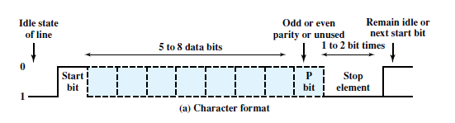
Asynchronous Transmission
.

Slide 6
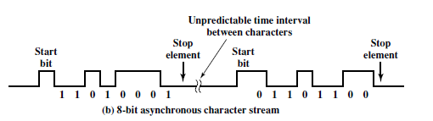
Asynchronous Transmission
.

Slide 7
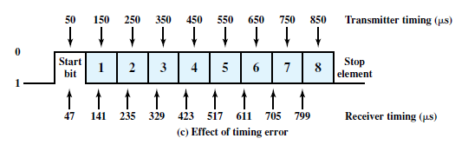
Asynchronous Transmission
data rate of 10,000 bits per second (10 kbps);
each bit is of 0.1 millisecond (ms), or duration.
Assume that the receiver is fast by 6%, or per bit time.
Thus, the receiver samples the incoming character every
.

Slide 8
Asynchronous Transmission
simple and but requires an overhead of two to three bits per character.
For 8-bit character the overhead is 20%.
.

Slide 9
Synchronous Transmission
Block of bits is transmitted
To prevent timing drift clocks must be synchronized.
One possibility is to provide a separate clock line.
  works well over short distances.
Other alternative is to embed the clocking information in the data signal.
.

Slide 10

Synchronous Transmission
Figure 6.2 Synchronous Frame Format
Starts with a preamble called a flag.
Same flag is used as a postamble.
Receiver looks for the occurrence of the flag pattern to signal the start of a frame.
The data plus preamble, postamble, and control information are called a frame
.

Slide 11
Synchronous Transmission
HDLC , contains 48 bits of control, preamble, and postamble.
If each black has 1000-character =1000 * 8 =8000 bits of data.
percentage overhead of only 48/8048 * 100% = 0.6%.
.

Slide 12
END
.

